Slide 1

Introduction to algorithms
Seminar 10
w/c: 6 December 2021

Slide 2
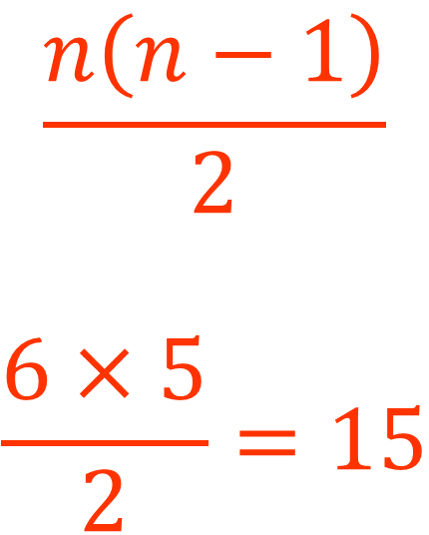
Complete graphs
Draw a complete graph with 6 vertices. How many edges do you need to draw?
A
Edges=
5+
$$\frac{n\left(n−1\right)}{2}$$
$$\frac{6×5}{2}=15$$
F
4+
B
3+
E
2+
C
D
1=15

Slide 3
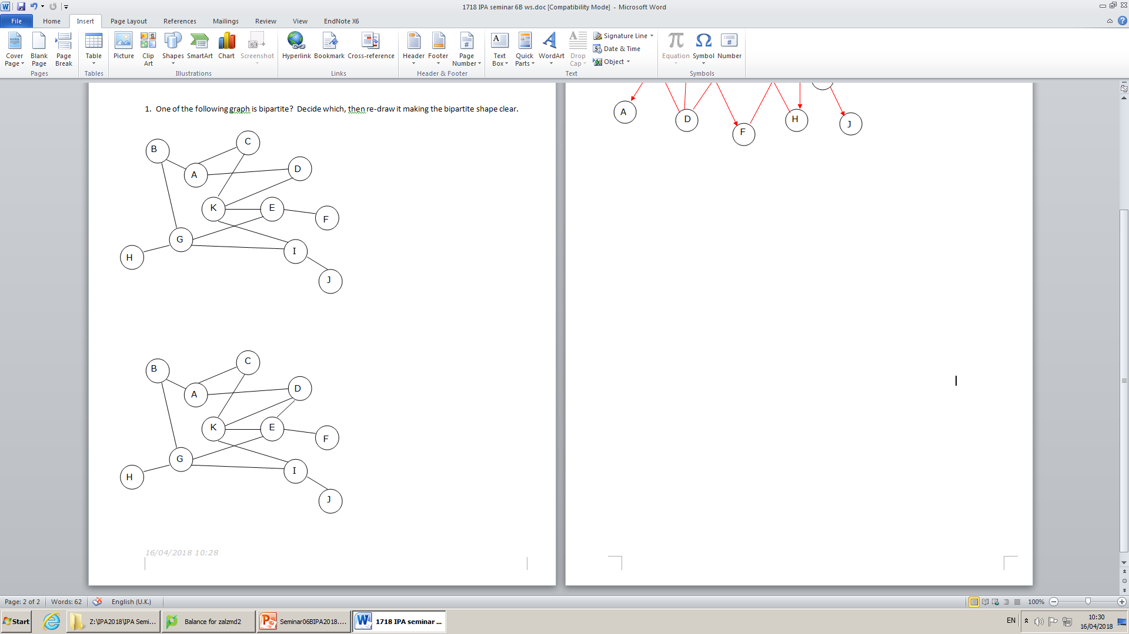
Bipartite graphs
Which one is bipartite?
√
×
Reason?
Triangular Cycle!!

Slide 4
Split the vertices into two sets
B
D
A
B
A
C
E
K
J
H
I
J
K
H
F
E
F
C
D
G
I
G
No triangular cycles

Slide 5
Eulerian tour? Eulerian path?
For an Eulerian tour all vertices must be of even degree
NO Eulerian tour
For an Eulerian path at most 2 vertices of odd degree
Has an Eulerian path
Start at R and end in T or vice versa.
END
odd
odd

Slide 6
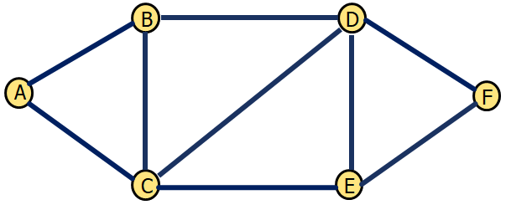

School bus routing
Find a path from SCHOOL to SCHOOL for the bus. Each street MUST be traversed only ONCE!
Does such path exist??
Yes! Eulerian tour
SCHOOL

Slide 7
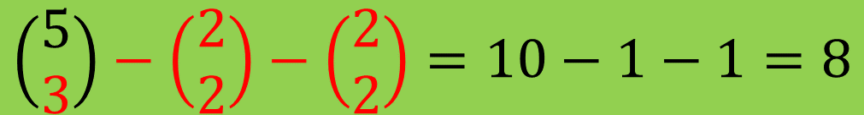

Counting the spanning trees
A
$$\left|V\right|=4, \left|E\right|=5, \left|E_{s}\right|=3$$
Delete any two edges
A
A
A
…
D
B
D
B
D
B
D
B
C
C
C
C
A
A
A
$$\left(\begin{matrix}5 \\ 3\end{matrix}\right)−\left(\begin{matrix}2 \\ 2\end{matrix}\right)−\left(\begin{matrix}2 \\ 2\end{matrix}\right)=10−1−1=8$$
D
B
D
B
D
B
C
C
C

Slide 8
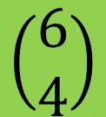

Counting the spanning trees
A
B
$$\left|V\right|=5, \left|E\right|=6, \left|E_{s}\right|=4$$
Delete any two edges
A
B
A
B
A
B
A
B
D
C
D
D
D
D
C
C
C
C
E
E
E
E
E
$$\left(\begin{matrix}6 \\ 4\end{matrix}\right)$$

Slide 9
Counting the spanning trees
A
B
$$\left|V\right|=5, \left|E\right|=6, \left|E_{s}\right|=4$$
Delete any two edges
A
B
A
B
A
B
A
B
D
C
D
D
D
D
C
C
C
C
E
E
E
E
E
$$\left(\begin{matrix}6 \\ 4\end{matrix}\right)$$

Slide 10
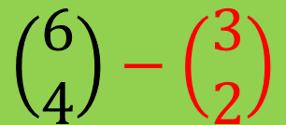
Counting the spanning trees
A
B
$$\left|V\right|=5, \left|E\right|=6, \left|E_{s}\right|=4$$
Delete any two edges
A
B
A
B
A
B
A
B
D
C
D
D
D
D
C
C
C
C
E
E
E
E
E
$$\left(\begin{matrix}6 \\ 4\end{matrix}\right)−\left(\begin{matrix}3 \\ 2\end{matrix}\right)$$

Slide 11
Counting the spanning trees
A
B
$$\left|V\right|=5, \left|E\right|=6, \left|E_{s}\right|=4$$
Delete any two edges
A
B
A
B
A
B
A
B
D
C
D
D
D
D
C
C
C
C
E
E
E
E
E
$$\left(\begin{matrix}6 \\ 4\end{matrix}\right)−\left(\begin{matrix}3 \\ 2\end{matrix}\right)$$

Slide 12
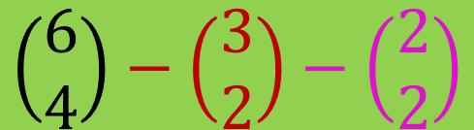

Counting the spanning trees
A
B
$$\left|V\right|=5, \left|E\right|=6, \left|E_{s}\right|=4$$
Delete any two edges
A
B
A
B
A
B
A
B
D
C
D
D
D
D
C
C
C
C
E
E
E
E
E
$$\left(\begin{matrix}6 \\ 4\end{matrix}\right)−\left(\begin{matrix}3 \\ 2\end{matrix}\right)−\left(\begin{matrix}2 \\ 2\end{matrix}\right)$$
$$=15−3−1=11$$
spanning trees

Slide 13
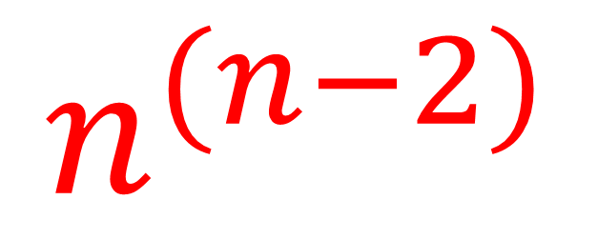
Spanning trees of a complete graph with n vertices
The number of spanning trees of a complete graph with n vertices:
$$n^{(n−2)}$$

Slide 14
Find the minimum spanning tree (MST) – kruskal
EDGES SELECTED: 1
C
5
G
2
H
2
3
1
3
B
8
3.8
I
F
6
3.5
3
2
4
A
D
E
J
2
1
4

Slide 15
Find the minimum spanning tree (MST) – kruskal
EDGES SELECTED: 2
C
5
G
2
H
2
3
1
3
B
8
3.8
I
F
6
3.5
3
2
4
A
D
E
J
2
1
4

Slide 16
Find the minimum spanning tree (MST) – kruskal
EDGES SELECTED: 3
C
5
G
2
H
2
3
1
3
B
8
3.8
I
F
6
3.5
3
2
4
A
D
E
J
2
1
4

Slide 17
Find the minimum spanning tree (MST) – kruskal
EDGES SELECTED: 4
C
5
G
2
H
2
3
1
3
B
8
3.8
I
F
6
3.5
3
2
4
A
D
E
J
2
1
4

Slide 18
Find the minimum spanning tree (MST) – kruskal
EDGES SELECTED: 5
C
5
G
2
H
2
3
1
3
B
8
3.8
I
F
6
3.5
3
2
4
A
D
E
J
2
1
4

Slide 19
Find the minimum spanning tree (MST) – kruskal
EDGES SELECTED: 6
C
5
G
2
H
2
3
1
3
B
8
3.8
I
F
6
3.5
3
2
4
A
D
E
J
2
1
4

Slide 20
Find the minimum spanning tree (MST) – kruskal
EDGES SELECTED: 7
C
5
G
2
H
2
3
1
3
B
8
3.8
I
F
6
3.5
3
2
4
A
D
E
J
2
1
4

Slide 21
Find the minimum spanning tree (MST) – kruskal
EDGES SELECTED: 8
C
5
G
2
H
2
3
1
3
B
8
3.8
I
CYCLE!!
F
6
3.5
3
2
4
A
D
E
J
2
1
4

Slide 22
Find the minimum spanning tree (MST) – kruskal
EDGES SELECTED: 8
C
5
G
2
H
2
3
1
3
B
8
3.8
I
CYCLE!!
F
6
3.5
3
2
4
A
D
E
J
2
1
4

Slide 23
Find the minimum spanning tree (MST) – kruskal
EDGES SELECTED: 8
C
5
G
2
H
2
3
1
3
B
8
3.8
I
CYCLE!!
F
6
3.5
3
2
4
A
D
E
J
2
1
4

Slide 24
Find the minimum spanning tree (MST) – kruskal
EDGES SELECTED: 8
C
5
G
2
H
2
3
1
3
B
8
3.8
I
F
6
3.5
3
2
4
A
D
E
J
2
1
4

Slide 25
Find the minimum spanning tree (MST) – kruskal
EDGES SELECTED: 9
C
5
G
2
H
2
3
1
3
B
8
3.8
I
F
STOP!!
6
3.5
3
2
4
A
D
E
J
2
1
4

Slide 26
Find the minimum spanning tree (MST) – kruskal
EDGES SELECTED: 9
C
G
2
H
2
3
1
B
I
F
3
2
A
D
E
J
2
1
4
MINUMUM COST= 1+1+2+2+2+2+3+3+4 =20

Slide 27
Find the minimum spanning tree (MST) – PRIM
EDGES SELECTED: 1
C
5
G
2
H
2
3
1
3
B
8
3.8
I
F
6
3.5
3
2
4
A
D
E
J
2
1
4

Slide 28
Find the minimum spanning tree (MST) – PRIM
EDGES SELECTED: 2
C
5
G
2
H
2
3
1
3
B
8
3.8
I
F
6
3.5
3
2
4
A
D
E
J
2
1
4

Slide 29
Find the minimum spanning tree (MST) – PRIM
EDGES SELECTED: 3
C
5
G
2
H
2
3
1
3
B
8
3.8
I
F
6
3.5
3
2
4
A
D
E
J
2
1
4

Slide 30
Find the minimum spanning tree (MST) – PRIM
EDGES SELECTED: 4
C
5
G
2
H
2
3
1
3
B
8
3.8
I
F
6
3.5
3
2
4
A
D
E
J
2
1
4

Slide 31
Find the minimum spanning tree (MST) – PRIM
EDGES SELECTED: 5
C
5
G
2
H
2
3
1
3
B
8
3.8
I
F
6
3.5
3
2
4
A
D
E
J
2
1
4

Slide 32
Find the minimum spanning tree (MST) – PRIM
EDGES SELECTED: 6
C
5
G
2
H
2
3
1
3
B
8
3.8
I
F
6
3.5
3
2
4
A
D
E
J
2
1
4

Slide 33
Find the minimum spanning tree (MST) – PRIM
EDGES SELECTED: 7
C
5
G
2
H
2
3
1
3
B
8
3.8
I
F
6
3.5
3
2
4
A
D
E
J
2
1
4

Slide 34
Find the minimum spanning tree (MST) – PRIM
EDGES SELECTED: 8
C
5
G
2
H
2
3
1
3
B
8
3.8
I
F
6
3.5
3
2
4
A
D
E
J
2
1
4

Slide 35
Find the minimum spanning tree (MST) – PRIM
EDGES SELECTED: 9
C
5
G
2
H
2
3
1
3
B
8
3.8
I
F
STOP!!
6
3.5
3
2
4
A
D
E
J
2
1
4

Slide 36
Find the minimum spanning tree (MST) – PRIM
EDGES SELECTED: 9
C
G
2
H
2
3
1
B
I
F
3
2
4
A
D
E
J
2
1
MINUMUM COST= 1+1+2+2+2+2+3+3+4 =20

